Slide 1
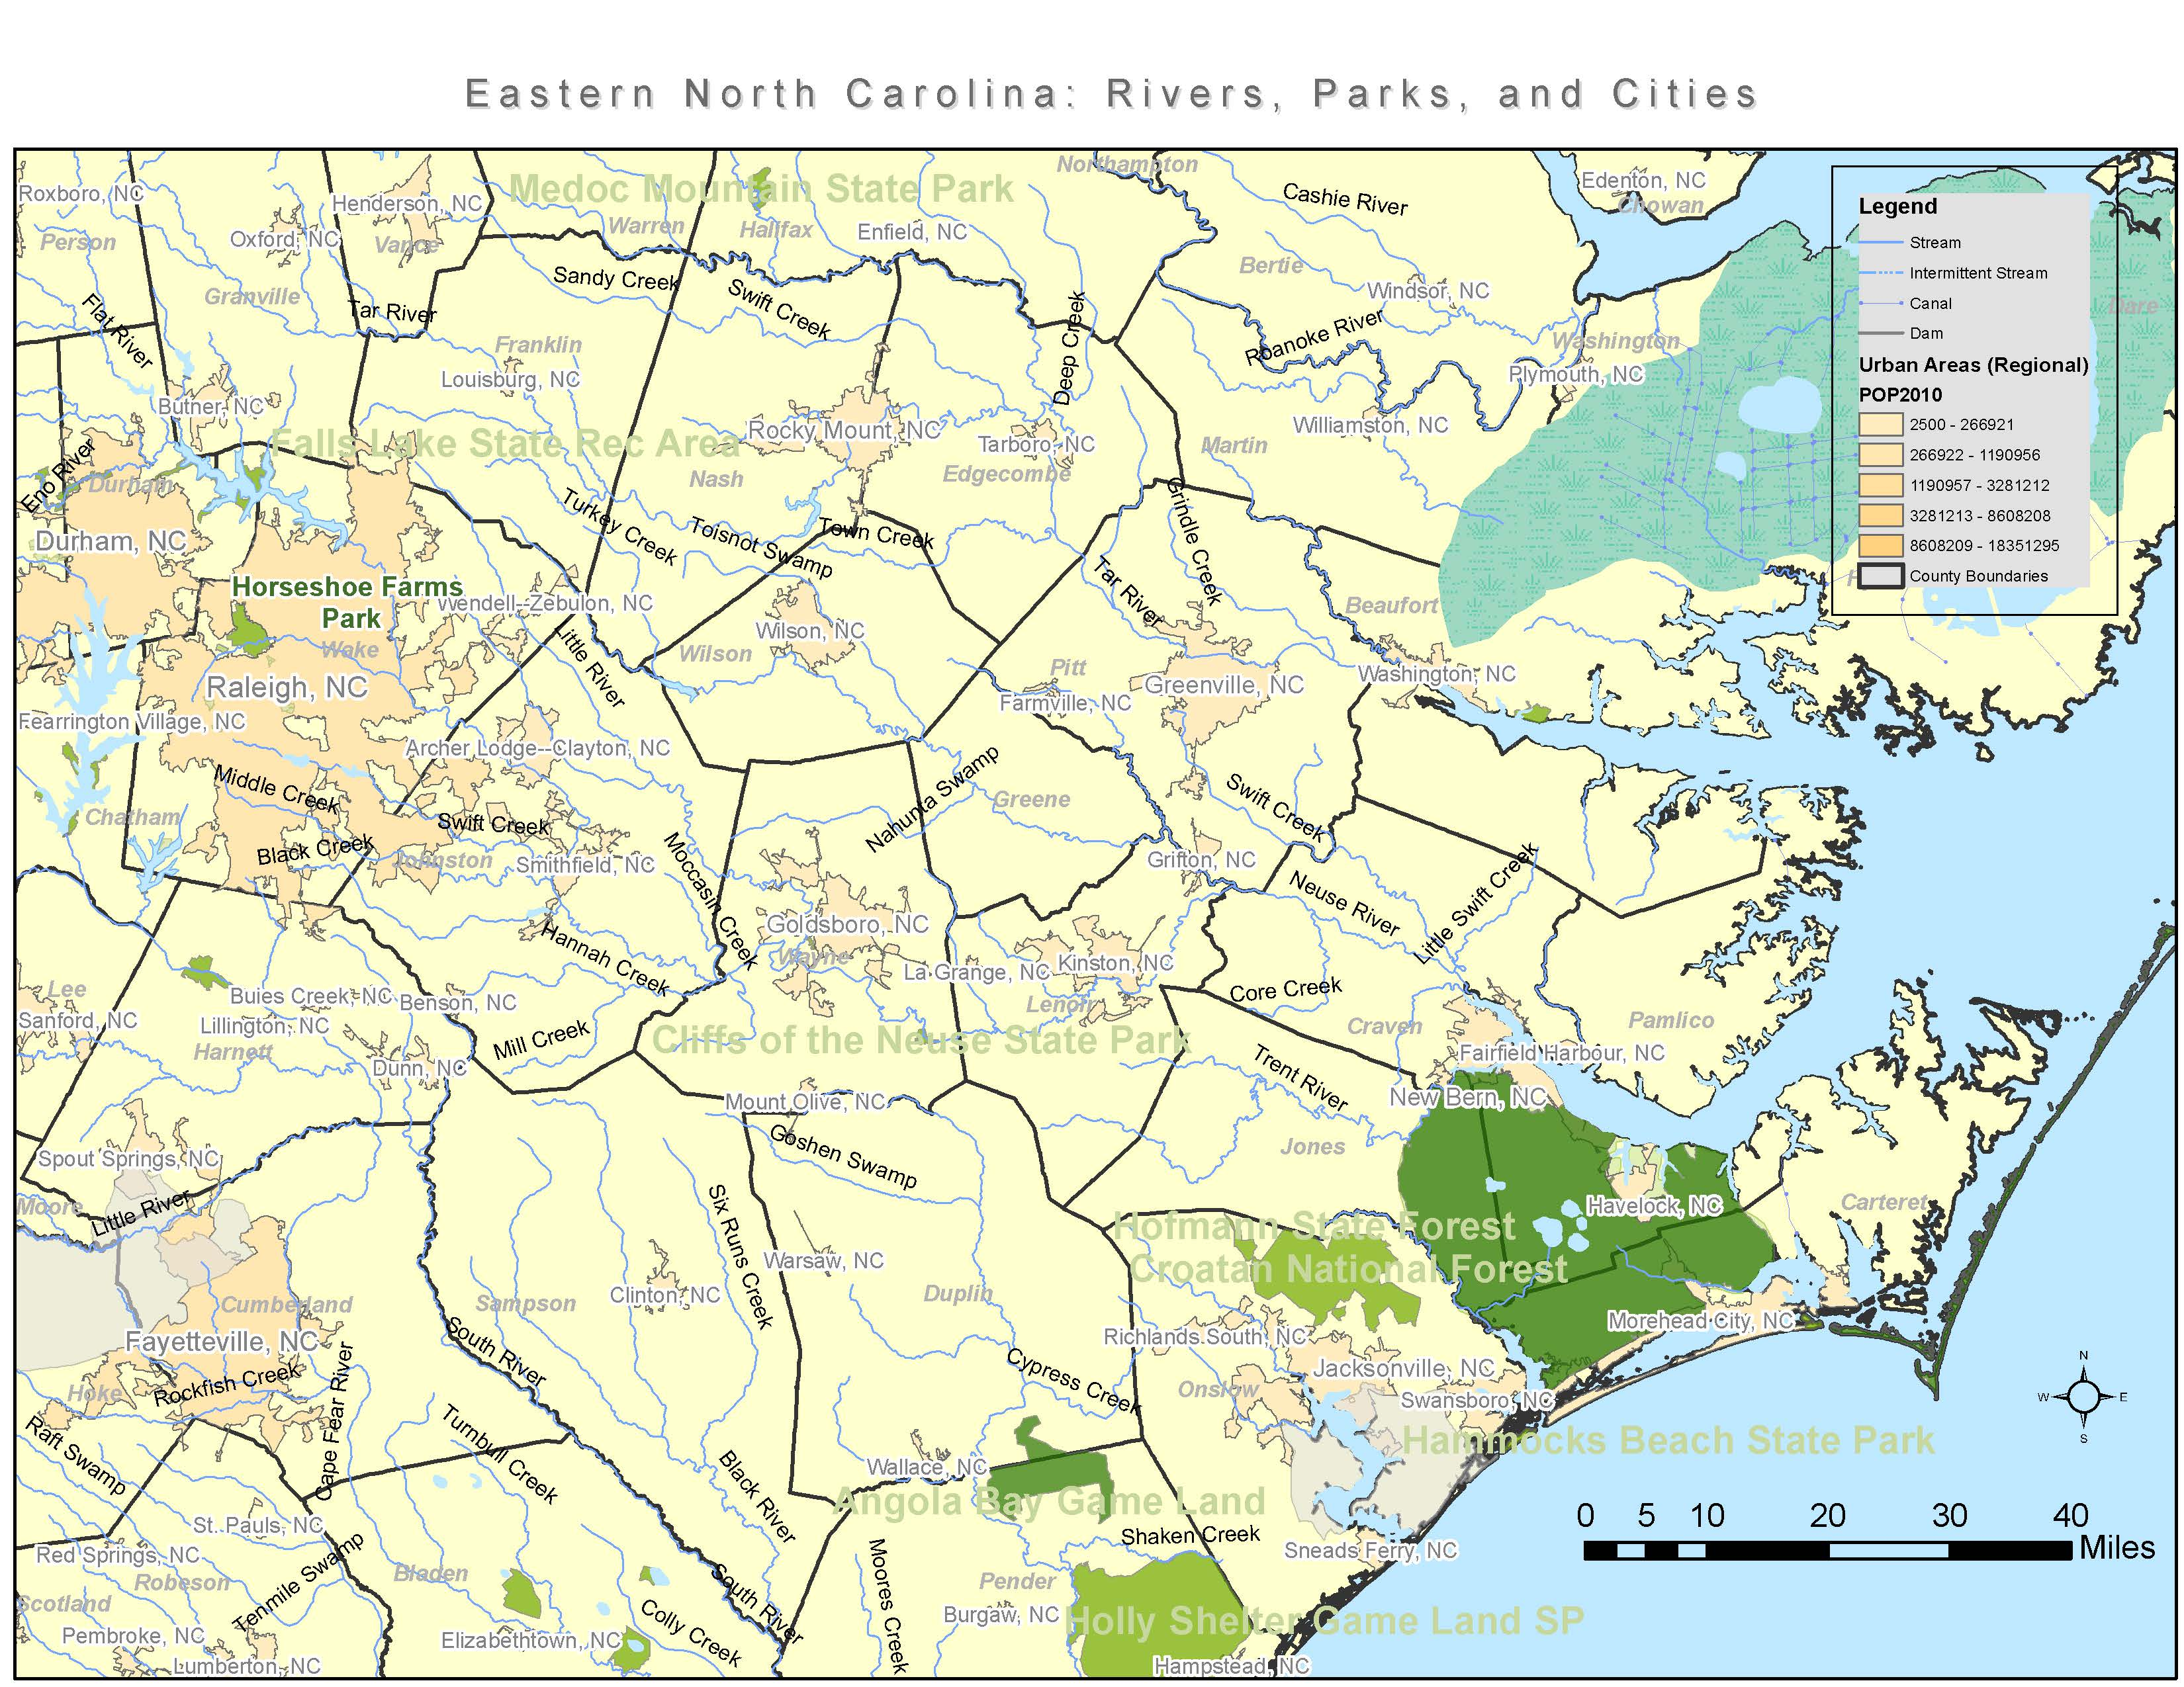
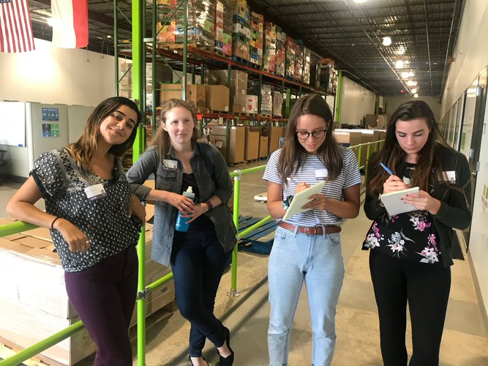
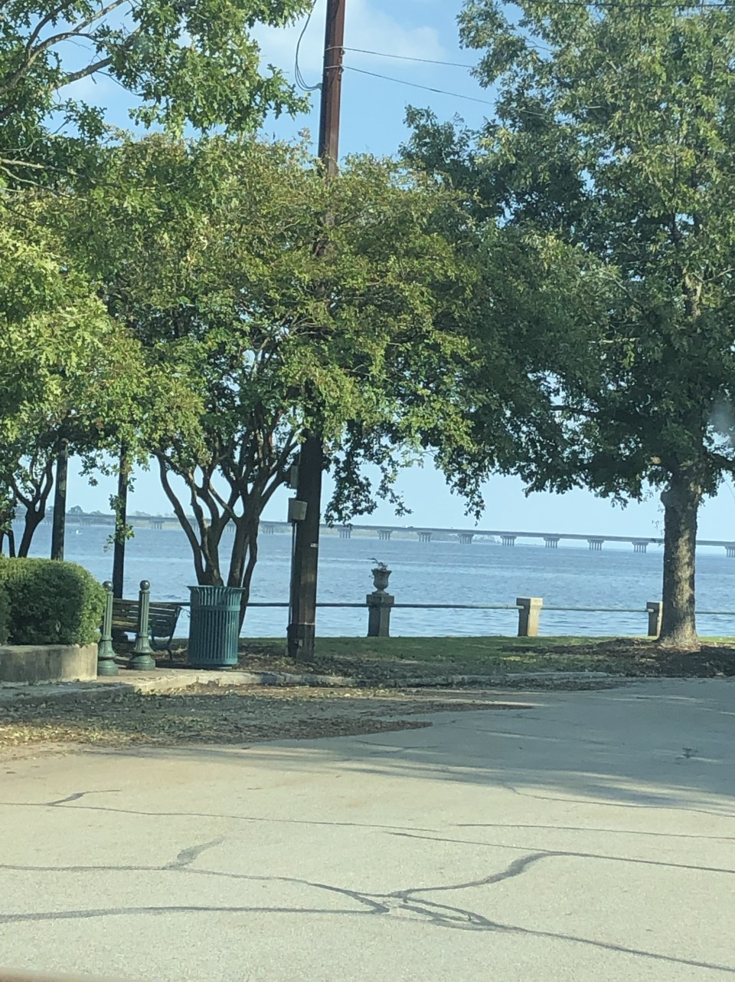
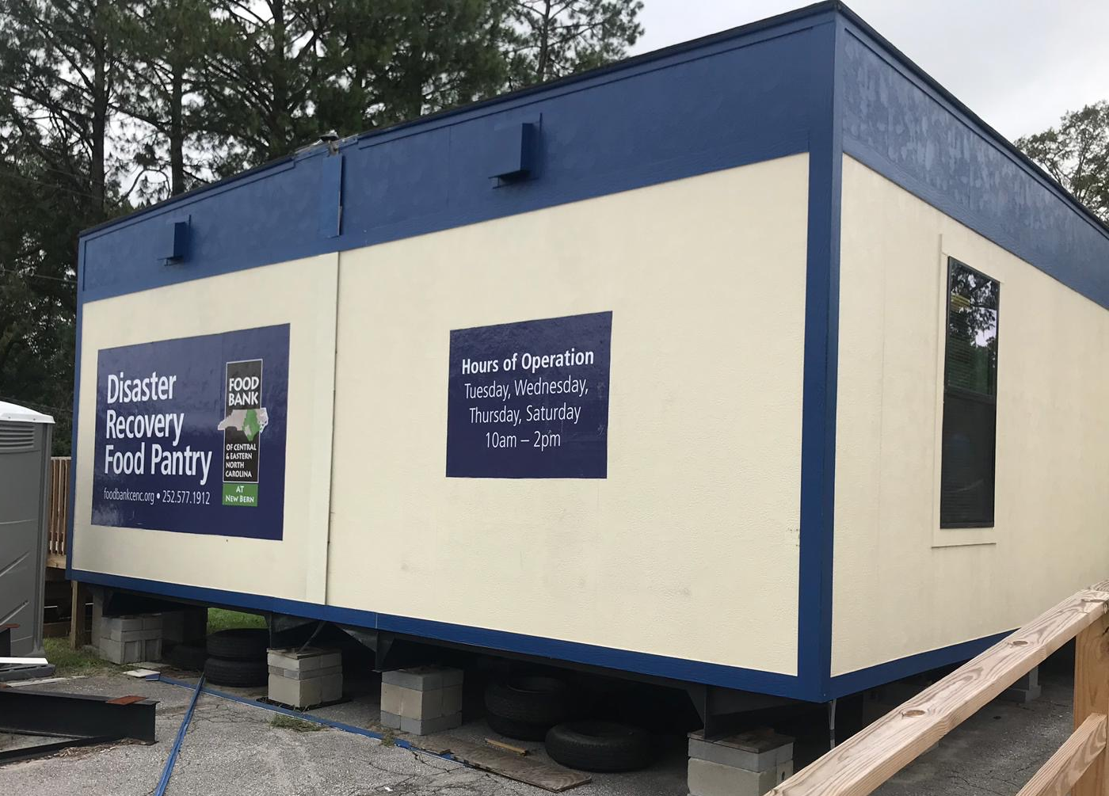
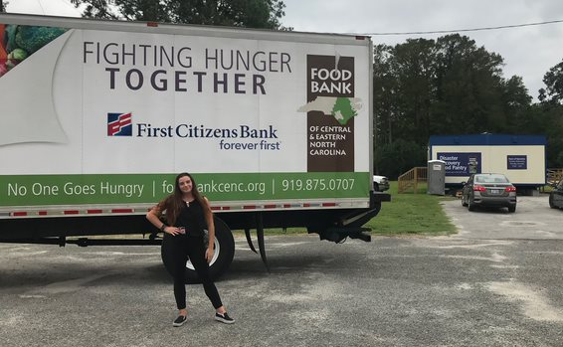
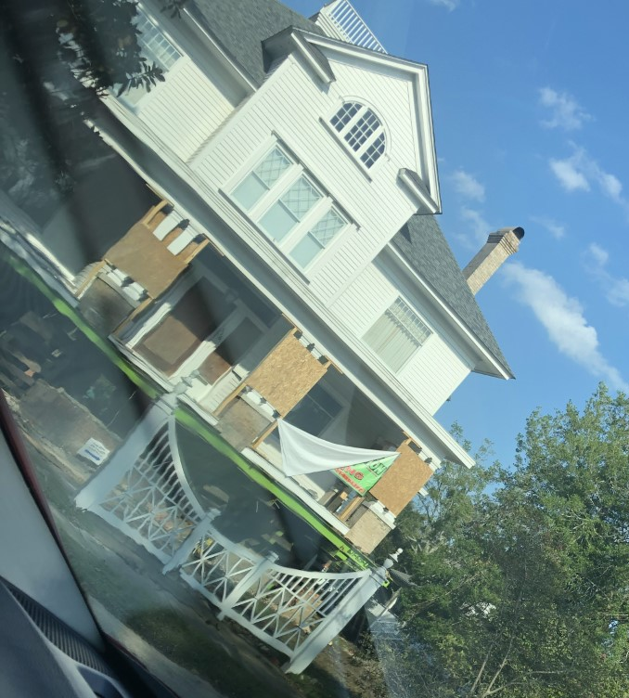
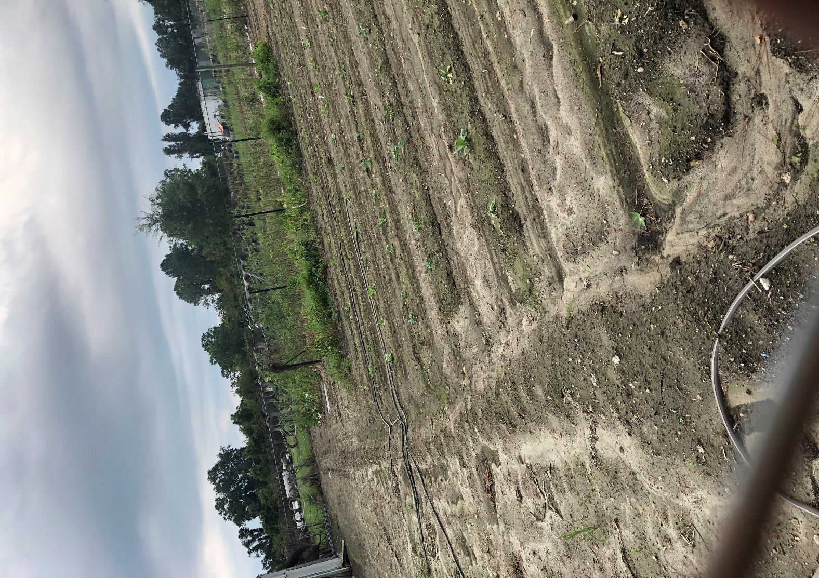
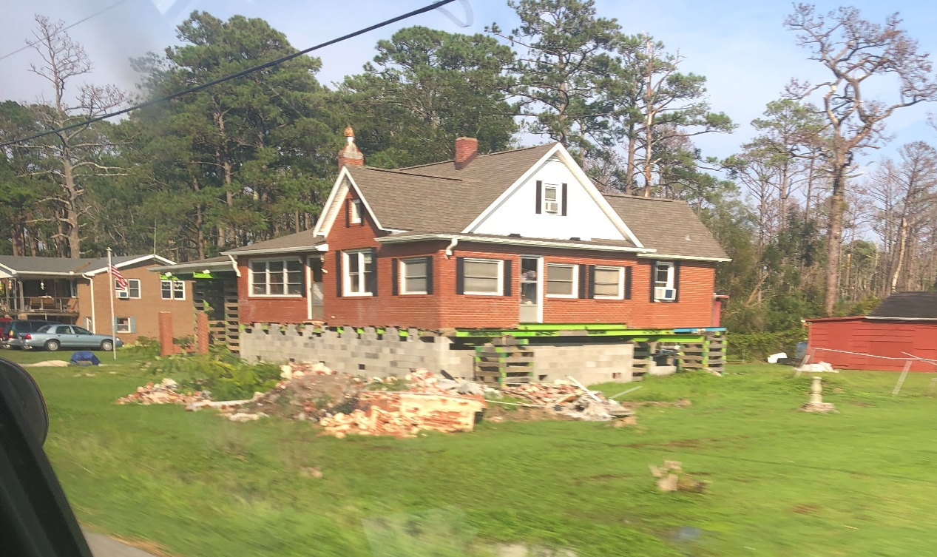
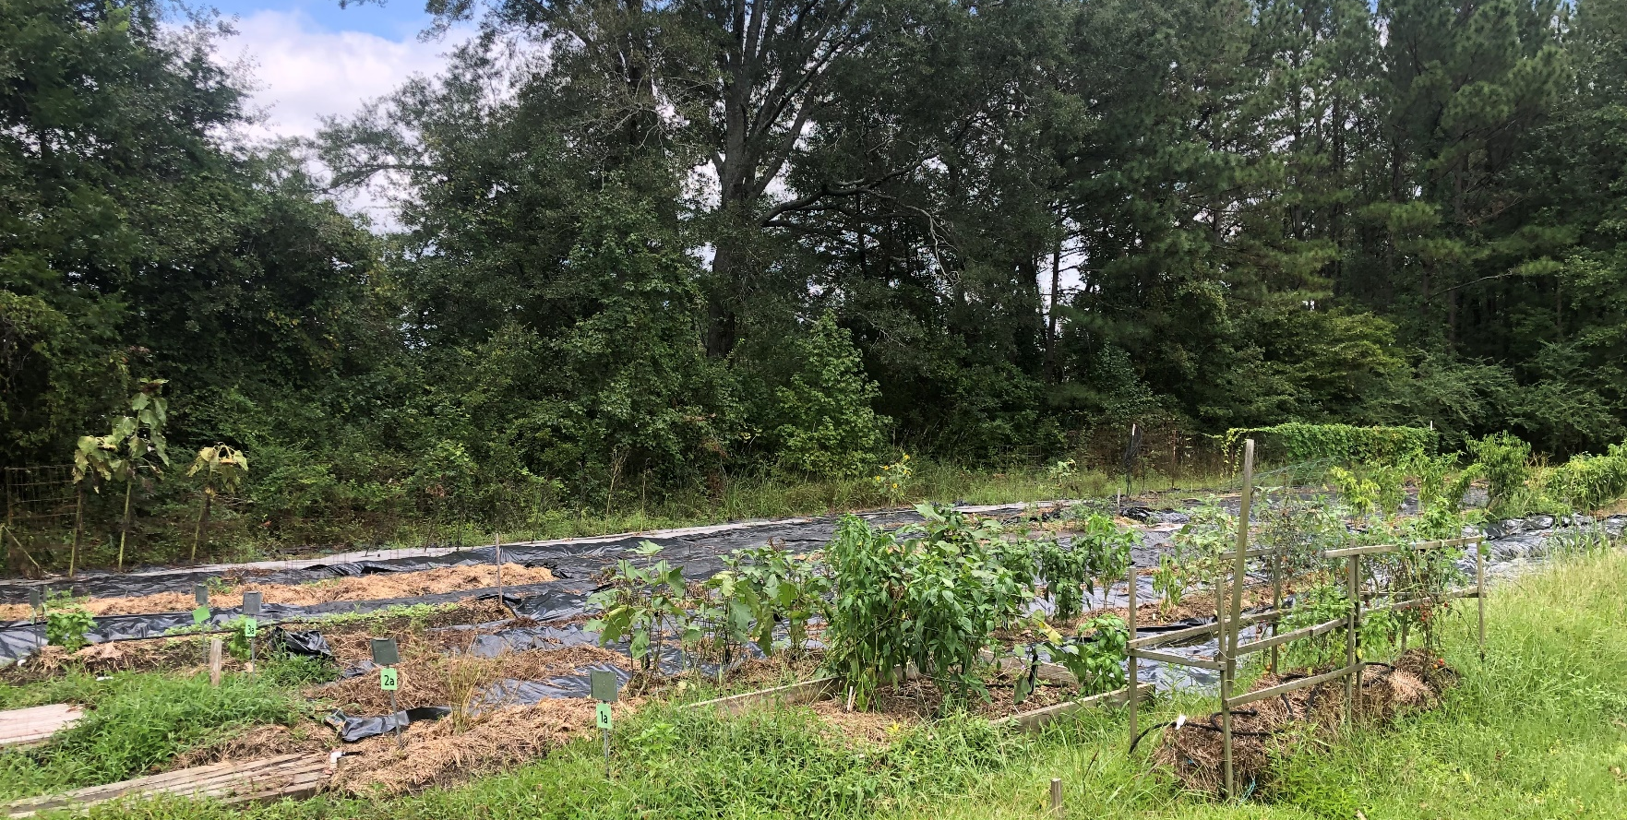
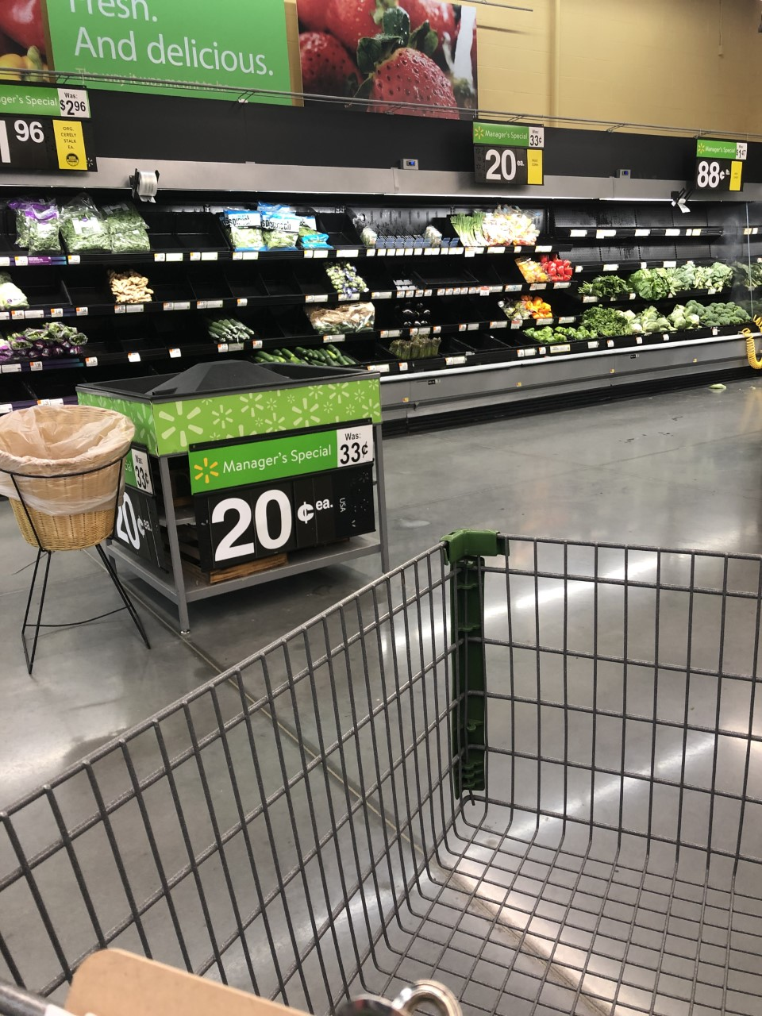

Food Insecurity Post Hurricane Florence One Year Anniversary and Hurricane Dorian
Analeeza Leggett¹ ​
Public Health, Undergraduate, Senior
¹Department of Health Administration and Public Health, D’Youville College
PURPOSE OF RESEARCH
To better understand food environments post-disasters, to provide information for policy’s and interventions to better help people in disasters and post-disaster.
INTRODUCTION
I traveled with a team of five to New Bern, North Carolina one-year post-Hurricane Florence and one day after Hurricane Dorian. New Bern is a small town on the coast of North Carolina, located in Craven County; about two hours south of Raleigh. The town is located between two rivers, the Neuse River and the Trent River.
KEY FINDINGS
Farmers are moving away from NC
agriculture due to disasters
Farmers cannot afford to stay in agriculture
in NC
People are moving to cities because they don’t
have homes/work in the County
Rural food insecurity is a problem
TAKEAWAYS
What I learned:
There is a real cost of climate change on agriculture
The increase in frequency of disasters has flooded
North Carolina farms, leading to produce loss.
Climate change has begun to change the crop
seasons, increasing produce prices.
Disasters are leading to population changes
An expansion in urban agriculture will become necessary
How it’s impacted my professional/academic path:
This experience provoked a desire to research and create programs geared towards creating equitable access to healthy food for our growing urban environments due to climate change
I saw the disproportionate impact of disasters on vulnerable populations further motivating my inclination towards program planning for vulnerable populations
FUTURE DIRECTIONS
Acknowledgements
Plans for getting to my career goals include graduate school, MPH
Prepare for a Career in program planning, interventions, and evaluation
Career goal to eliminate food insecurity in my community and create more urban agriculture
I'd like to thank Dr. Clay for always pushing me to do my best and for opening so many opportunities for me to grow to become a public health professional. I'd also like to thank Dr. Penta for teaching me about reconnaissance and for encouraging me to further my education.
CHALLENGES
Long hours
Some organizations are more receptive than others

